Slide 1
Overview
Amity is seeking +/- $125,000 to grow its digital learning platform for college students and teachers.
Amity is a centralized discussion platform that aims to optimize classroom discussion and engagement in college classes through the perfect balance of asynchronous and synchronous discussion.
Revenue plans on being derived from either students, professors, departments, or colleges depending on the plan.
Teachers create classrooms on the digital platform and are able to facilitate and create centralized online spaces for their students to connect, communicate and collaborate outside of the classroom.
Plans are to beta-test early Q2 of 2021 at Dartmouth, Emory, and University of Michigan. Based on the traction and results there are plans to expand the reach of the colleges beginning Fall of 2021.
Projected revenue from multiple market segments: $20,000 in 2020 and $165,000 in 2022.
Led by Abraham Joo
Current Senior at Dartmouth College Class of ‘21.
Experienced and worked in business development for multiple SaaS startups.
Knowledgeable in the market of LMS and LTI.
Notes:
Socioeconomic growth stunted by lack of educational success which leads to oppo

Slide 2
Opportunity
75% of Class
19.9 Million
$29.2 Billion
For students is spent outside of the classroom studying
Students Enrolled in U.S. Colleges in 2019
Market size in 2019 for LMS with a CAGR of 16.3%
Notes:
Socioeconomic growth stunted by lack of educational success which leads to oppo

Slide 3
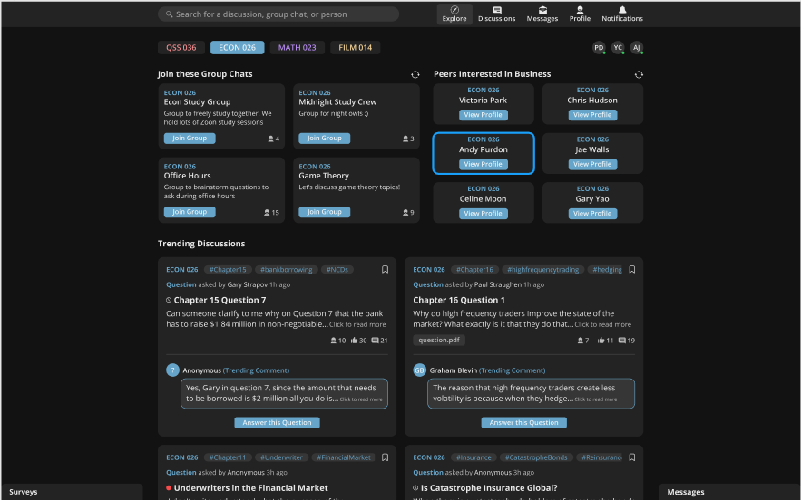
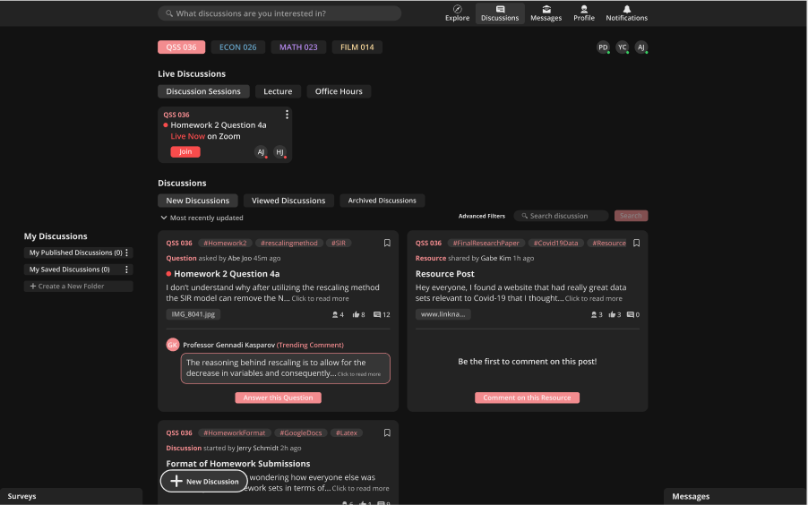
Solution
Amity aims to help teachers facilitate an online discussion space for students to collaborate, communicate, and connect outside of the classroom while providing actionable analytics for teachers to drive discussion during class.
With an array of key features such as:
An intuitive and modern discussion board for all forms of discussion (Q&A, live calls, etc.)
Anonymous participation to invigorate participation
Explore page to help connect students and increase engagement
Data-Driven Analytics for teachers
Centralized messaging platform
Notes:
Socioeconomic growth stunted by lack of educational success which leads to oppo

Slide 4
Management
Abraham Joo, CEO & Co-Founder
Worked for multiple technology startups in the SaaS space as a business development manager. A current senior at Dartmouth College majoring in economics and mathematics. Has been pivoting from a sales and marketing background to a more strategic based leadership position. Created and executed multiple successful business strategies to close over $50,000 revenue in 3 months for small startups.
Gabe Kim, CTO & Co-Founder
Experienced full stack developer who is currently a senior at Emory College majoring in computer science and applied mathematics. Built a multitude of applications for desktop and mobile for large groups of live users. Worked for the Oak Ridge National Lab to help research and develop NLP algorithms for Health Data trends.
Yunji Chung, CPO & Co-Founder
Experienced UI/UX designer whose worked at the likes of Mailchimp, Coca-Cola Company, Cochl., and more. Incoming Masters degree candidate at Carnegie Mellon University for Human-Computer Interactions. Has designed and implemented a multitude of products from various stages: scratch to multiple-iteration products.
Notes:
Socioeconomic growth stunted by lack of educational success which leads to oppo

Slide 5
Sources & Uses
Sources:
Investor Capital $125,000
TOTAL $125,000
Uses:
Marketing $12,500
Software Development $60,000
Working Capital $40,000
Closing Expenses/Fees $12,500
TOTAL $125,000
Notes:
Socioeconomic growth stunted by lack of educational success which leads to oppo

